Slide 1
United States Department of Agriculture
National Agricultural Statistics Service
November Crop Report
November 20 Crop Progress and Condition
Nick Streff
USDA NASS
November 28, 2022

Slide 2
7-19-21

Slide 3
Notes:
Harvest progressed ahead of normal this year which is quite a change from last year.
As of 11/20, corn was 99% harvested.

Slide 4
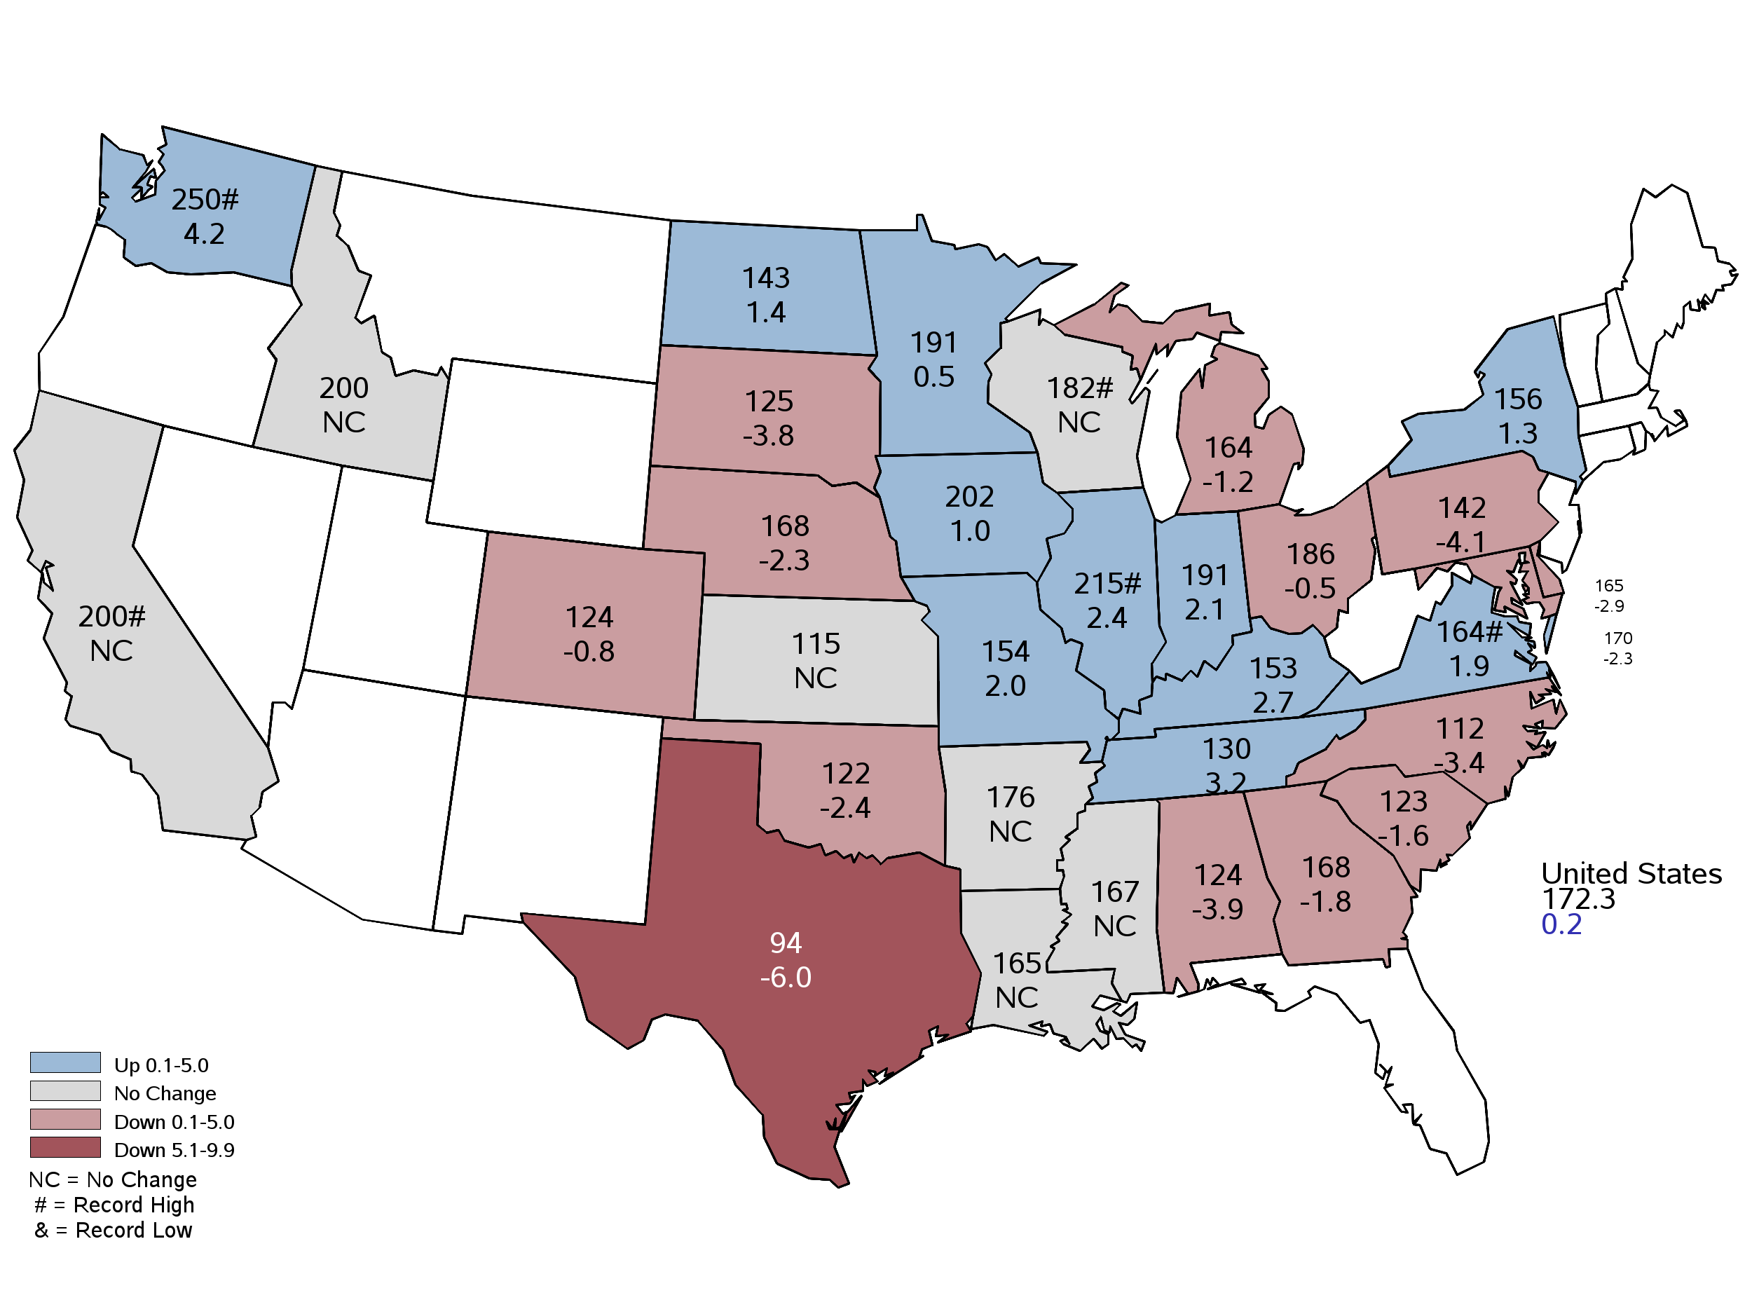
November 2022 Corn Yield
Bushels and Percent Change from Previous Month
November 9, 2022
Notes:
Corn Yield
Nebraska yield at 168.
Nebraska yield was 169 in 2013 and 142 in 2012

Slide 5
November 2022 Corn Production
Nebraska
Billion Bushels
Notes:
Corn Production
Nebraska's 2022 corn crop is forecast at 1.56 billion bushels, down 16% from last year's production, according to the USDA's National Agricultural Statistics Service. Area to be harvested for grain, at 9.30 million acres, is down 3% from a year ago. Yield is forecast at 168 bushels per acre, down 26 bushels from last year. 2021 was record yield at 194 bu an acre.

Slide 8
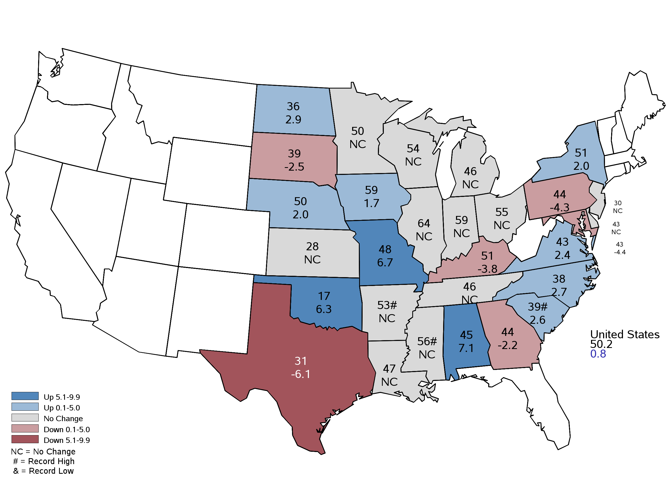
November 2022 Soybean Yield
Bushels and Percent Change from Previous Month
November 9, 2022
Notes:
Soybean Yield
Yield in 2012 was 41.5

Slide 9
November 2022 Soybean Production
Nebraska
Million Bushels
Notes:
Soybean production is forecast at 285 million bushels, down 19% from last year. Area for harvest, at 5.70 million acres, is up 2% from 2021. Yield is forecast at 50 bushels per acre, down 13.0 bushels from last year. Last year was a record yield and production.

Slide 10
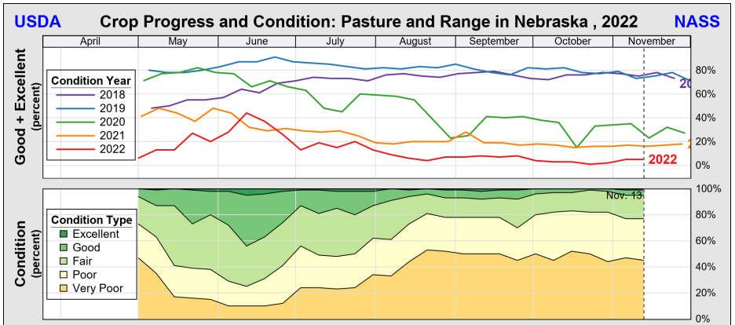

Slide 11
Crop Progress and Condition Report November 20, 2022
 | Very Short | Short | Adequate | Surplus
Topsoil Moisture | 48% | 39% | 13% | 0%
Subsoil Moisture | 51% | 38% | 11% | 0%
 | Very Poor | Poor | Fair | Good | Excellent
Winter Wheat Condition | 20% | 20% | 39% | 20% | 1%

Slide 12
October 2022 Crop Production
Nebraska
Alfalfa hay production, at 2.92 million tons, is down 22% from last year. Area for harvest, at 810,000 acres, is down 11% from a year ago. Yield of 3.60 tons per acre is down 0.50 ton per acre from 2021.
All other hay production, at 2.10 million tons, is down 18% from last year. Area for harvest, at 1.50 million acres, is down 9% from a year ago. Yield of 1.40 tons per acre is down 0.15 ton from 2021.

Slide 13
November 2022 Hay Production
Nebraska

Slide 14
Upcoming Events
Release Date | Title
December 13 | 2022 Census of Agriculture Mail out
December 15 | Small Grain County Estimates
December 23 | Cattle on Feed
December 23 | Hogs and Pigs
January 12 | Annual Crop Production
January 31 | Cattle

Slide 15
United States Department of Agriculture
National Agricultural Statistics Service
All Reports Available At
www.nass.usda.gov
Nicholas.Streff@usda.gov
For Questions
402-437-5541
800-582-6443

